Slide 1

Arrays
Behram Khan

Slide 2
Lecture Overview
In this first lecture we will cover the fundamental theoretical concepts that form the backbone of programming.
This session focuses solely on theory along with practical examples, providing a solid foundation for understanding computers and programming
Involving examples and interactive session to develop problem solving

Slide 3
Learning Objectives
By the end of this lecture, students will be able to:
Know how nested loops are executed
Know what is a switch statement
Learn about Arrays and 2D Arrays and its application
Know what are strings and string manipulation

Slide 4
Nested Loops

Slide 5
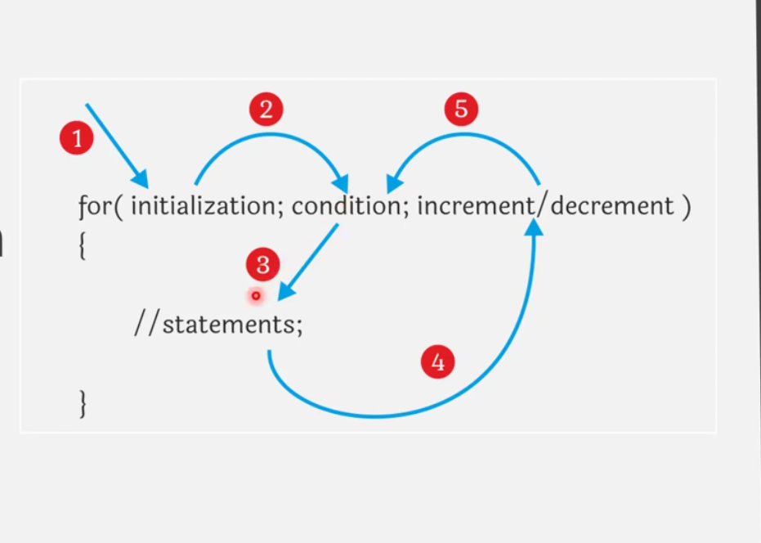
For Loop
Notes:
STR: Store a value to memory.
ADD: Add two values.
SUB: Subtract one value from another.
MOV: Move data from one location to another.

Slide 6
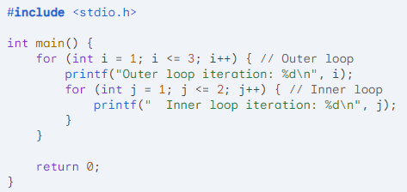
Nested For loop
Outer loop iteration: 1
Inner loop iteration: 1
Inner loop iteration: 2
Outer loop iteration: 2
Inner loop iteration: 1
Inner loop iteration: 2
Outer loop iteration: 3
Inner loop iteration: 1
Inner loop iteration: 2
Notes:
STR: Store a value to memory.
ADD: Add two values.
SUB: Subtract one value from another.
MOV: Move data from one location to another.

Slide 7

Nested For loop
#include <stdio.h>
int main() {
int rows = 5;
for (int i = 1; i <= rows; i++) {
// Print spaces before stars
for (int j = 1; j <= rows - i; j++) {
printf(" ");
}
// Print stars for the current row
for (int j = 1; j <= 2 * i - 1; j++) {
if (j == 1 || j == 2 * i - 1) {
printf("*");
} else {
printf(" ");
}
}
printf("\n");
}
return 0;
}
Notes:
STR: Store a value to memory.
ADD: Add two values.
SUB: Subtract one value from another.
MOV: Move data from one location to another.

Slide 8
Switch Statement

Slide 9
Switch Statement
A switch statement is a control flow statement that allows you to execute different code blocks based on the value of an expression.
It's particularly useful when you have multiple possible values for a variable and you want to perform different actions for each value.
switch (expression) {
case value1:
// Code to be executed if expression == value1
break;
case value2:
// Code to be executed if expression == value2
break;
// ...
default:
// Code to be executed if no case matches

Slide 10
Switch Statement
#include <stdio.h>
int main() {
int day = 3;
switch (day) {
case 1:
printf("Monday");
break;
case 2:
printf("Tuesday");
break;
case 3:
printf("Wednesday");
break;
// ... other cases
default:
printf("Invalid day");
}
return 0; }

Slide 11
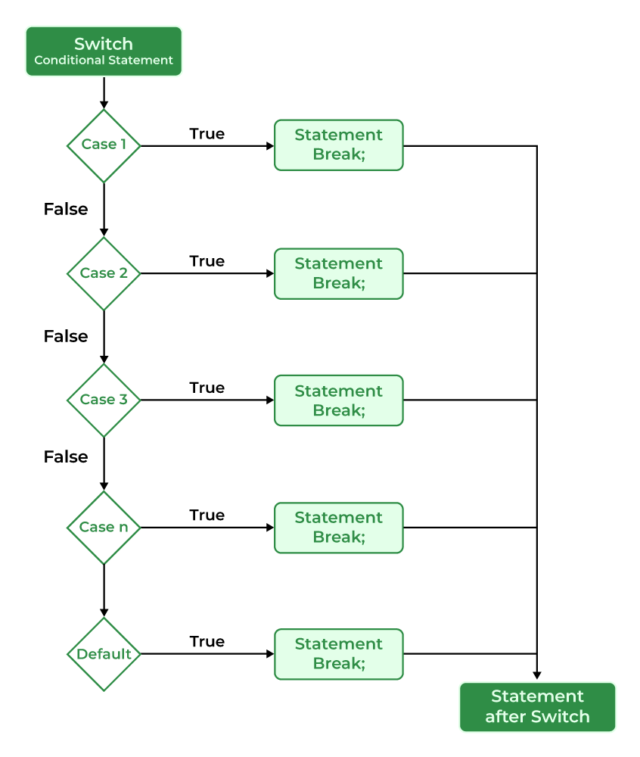
Switch Statement
https://byjus.com/gate/difference-between-if-else-and-switch/

Slide 12
Data Structure

Slide 13
Store Score of 50 Players and display it
Inputs : 50 Scores, meaning we need 50 variables.
Outputs: Int Player1Score; ……… Int Player 50Score;
Printf(“%i”, Player1Score); ... Printf(“%i”, Player50Score);
Meaning we need to write 50 lines of code to store Score and then 50 write 50 lines of code to print it.
Now what if we want to perform some calculation on the Score? For every calculation we need N+ lines of code.
This is difficult and the file will get very big and unreadable.
Solution? Array!!

Slide 14
What is an Array?
An array is a collection of elements of the same data type, stored in contiguous memory locations.
Elements of an array are placed one after another in memory.
Syntax:
Declaration : data_type array_name[array_size];
int numbers[5];
This declares an array named numbers that can hold 5 integer elements.
Index: value that identifies the position of an element within the array.

Slide 15
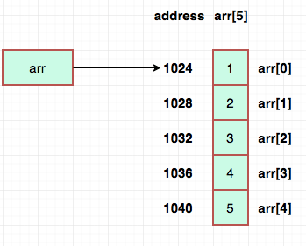
Key Points
Variables in an array share the same name and data type.
Individual variables are called elements.
Elements are accessed using index numbers.
Array indices start from 0.
Array size/Index must be a positive integer
Array elements can be accessed and modified
using their indices.

Slide 16
Different datatypes in arrays
int iArray[10];
Arrays index are zero-based; you start counting with the number zero up to the number defined in the brackets minus 1 (0, 1, 2, 3, 4, 5, 6, 7, 8, 9 gives you 10 elements).
float fAverages[30]; //Float data type array with 30 elements
Int Results[3]; // data type array with 3 elements
Char Name[19]; //Char array - 18 character elements and one null character

Slide 17
What is an Array?
Arrays are Fundamental data structure in programming used to store and organize data efficiently.
Data structure is a way of arranging data in a computer's memory so that it can be stored, accessed and used efficiently.

Slide 18

Initializing Array
int Array[5] = {0, 1, 2, 3, 4};
char Name[] = { 'O', 'l', 'i', 'v', 'i', 'a'}; //size in initialization is automatically set.
char Name[] = "Olivia";
For character types write them in single quotes.

Slide 19
Accessing Array Elements
We Access Elements of array using its index.
int Numbers[5] = {0, 1, 2, 3, 4};
Numbers[0] = 10; // Assign a value
printf("%d", iArray[0]); // Print the value
Int Evens[4];
Evens[0] = 0; Evens[1] = 2;….

Slide 20
Initializing using Loops
Another way to initialize your array elements is to use looping structures such as the for loop.
Int main()
{
int x;
int iArray[5];
for ( x = 0; x < 5; x++ )
{ iArray[x] = 0; }
}

Slide 21

Taking input from user and printing array
int main() {
int numbers[3];
for (int i = 0; i < 3; i++)
{
printf("Enter number %d: ", i + 1);
scanf("%d", &numbers[i]);
}
printf("Entered numbers:\n");
for (int i = 0; i < 3; i++)
{ printf("%d ", numbers[i]); }
printf("\n"); return 0;}

Slide 22
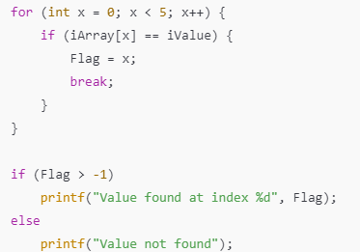
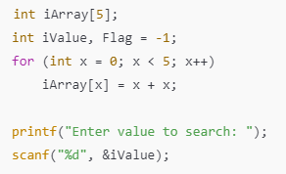
Searching in an Array

Slide 23
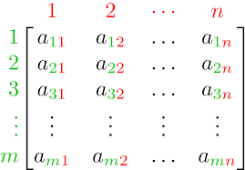
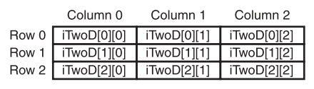
TWO-DIMENSIONAL ARRAYS
A 2D array is a collection of elements arranged in rows and columns, similar to a matrix or a table.

Slide 24
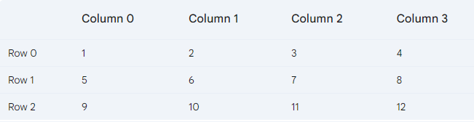















Declaration of 2D Array
Syntax:
data_type array_name[rows][columns];
int matrix[3][4]; // A 2D array with 3 rows and 4 columns
This creates a total of 12 (3x4) elements.

Slide 25

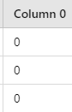
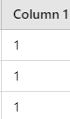
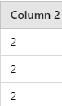
Initializing 2D Array
int TwoD[3][3] = { {0, 1, 2}, {0, 1, 2}, {0, 1, 2} };
Each set of braces {} represents a row.

Slide 26
Accessing Elements
array_name[row_index][column_index];
int value = matrix[1][2];
Access element in the second row, third column:

Slide 27
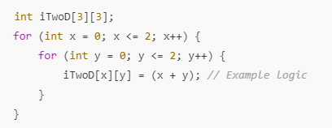
Initializing using nested for loop
How to print 2d array?
How to search element in 2d array?

Slide 28
Applications of 2D Arrays
Storing game boards (e.g., chess, tic-tac-toe).
Organizing tabular data structures.
Representing matrices.
Example: Matrix Operations
Adding two matrices:
for (int i = 0; i < rows; i++) {
for (int j = 0; j < cols; j++) {
result[i][j] = matrix1[i][j] + matrix2[i][j];
}
}

Slide 29
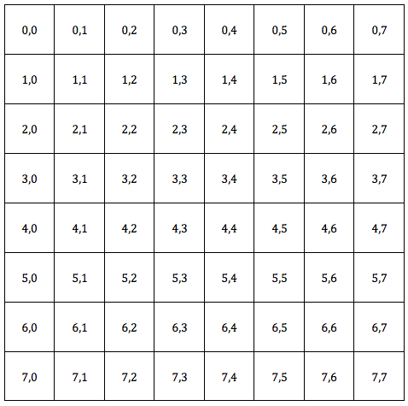
Applications of 2D Arrays
Chess Board 8x8

Slide 30
String

Slide 31
String
A string in C is a collection of characters stored in a character array, terminated with a special null character (\0).
Strings are widely used to store and manipulate text, such as names, messages, or sentences.
Declaration:
char name[10] = "Ali";
"Ali" is stored as {'A', 'l', 'i', '\0'} in memory.

Slide 32
Accessing String Elements
Each character in a string can be accessed using its index, starting from 0.
#include <stdio.h>
int main() {
char name[] = "Ali";
printf("First character: %c\n", name[0]); // Outputs 'A'
printf("Second character: %c\n", name[1]); // Outputs 'l'
return 0;
}

Slide 33
String Concatentaion(Joining Strings)
Concatenation is the process of joining two strings.
This can be done using the strcat() function from <string.h>.
#include <stdio.h>
#include <string.h>
int main() {
char first[20] = "Hello, ";
char second[] = "World!";
strcat(first, second); // Appends(adds to end) second to first
printf("Concatenated String: %s\n", first); // Outputs "Hello, World!"
return 0;
}

Slide 34
String Comparison
#include <stdio.h>
#include <string.h>
int main() {
char str1[] = "Ali";
char str2[] = "Ali";
if (strcmp(str1, str2) == 0) {
printf("Strings are equal.\n");
} else {
printf("Strings are not equal.\n");
}
return 0;
}
The strcmp() function is used to compare
two strings.
It returns(gives answer of):
0 if the strings are equal.
A negative value if the first string
is smaller.
A positive value if the first string
is larger.

Slide 35
String Length
The strlen() function returns the number of characters in a string, excluding the null character.
#include <stdio.h>
#include <string.h>
int main() {
char name[] = "Ali";
printf("Length of the string: %i\n", strlen(name)); // Outputs 3
return 0;
}

